Slide 1
HISTORY OF THE INTRODUCTION & USE OF BINARY NUMBERS
Notes:
*
For almost half a century, people attempted to invent an electronic computational device that could store all 10 digits in our decimal number system and even some of our alphabet. Scientist were attempting to store a charge in a vacuum tube, which is similar to a light bulb. The charge would later be “read” to determine what had been stored there. Each digit in our number system, one through nine, was stored with increasing degrees of charge, similar to a light bulb varying in power from dim all the way up to bright. However, the degree of “dimness” or “brightness” was difficult to measure, and it would change because the voltage in the equipment could not be accurately be regulated. For example, an eight would be stored with a particularly bright charge, but later it would be read as a seven or nine as the voltage on the vacuum tube fluctuated slightly.
Then, in the 1940’s John Atansoff came up with the brilliant idea to store and read only two values, on and off. Either there was a charge or there was not a charge, and this was easy to write and read, just as it’s easy to determine if a light bulb is on or off. This technology of storing and reading only two states is called binary, and the number system that only uses two digits, 0 and 1, is called the binary number system.

Slide 2
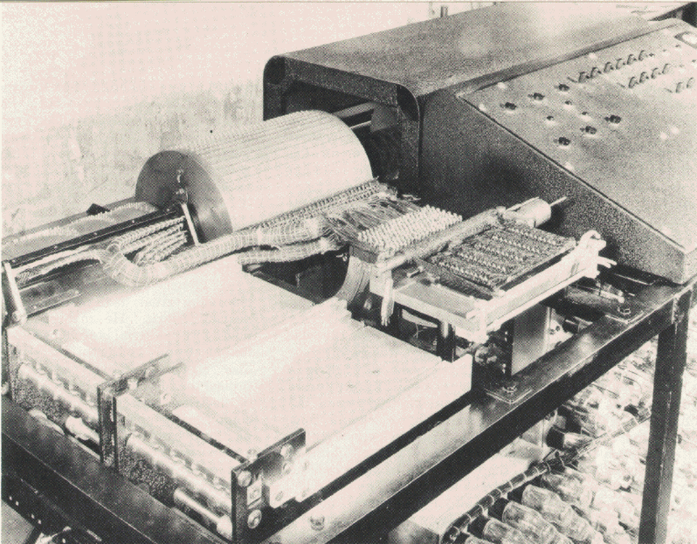
Atanasoff-Berry Computer
Built by John Vincent Atanasoff and Clifford Berry at Iowa State University during 1937 - 1942.
It incorporated several major innovations in computing including:
use of binary arithmetic
regenerative memory
parallel processing
separation of memory and computing functions.
Notes:
*
The Atanasoff-Berry Computer was the world's first electronic digital computer. It was built by John Vincent Atanasoff and Clifford Berry at Iowa State University during 1937-42. It incorporated several major innovations in computing including the
use of binary arithmetic, regenerative memory, parallel processing, and separation of memory and computing functions.
On October 19, 1973, US Federal Judge Earl R. Larson signed his decision following a lengthy court trial which declared the
ENIAC patent of Mauchly and Eckert invalid and named Atanasoff the inventor of the electronic digital computer -- the
Atanasoff-Berry Computer or the ABC

Slide 3
The data used by the computer is represented by the electrical state that the computer is in.
In other words whether the computer is in an electrical state of “on” or “off”. This two state system is known as binary representation.
1 = On
0 = Off

Slide 4
BINARY NUMBERS
Represented by the electrical state that the computer is in
Known as binary representation.
Notes:
*
The data used by the computer is represented by the electrical state that the computer is in or in other words whether the computer is in an electrical state of on or off. This two state system is known as binary representation.

Slide 5
Most modern computer systems operate using binary logic.
The computer represents values using two voltage levels (usually 1 for on and 0 for off.)
With two levels we can represent exactly two different values.

Slide 6
Decimal Number Spacing
In the United States among other countries, every three decimal digits are separated with a comma to make larger numbers easier to read.
For example, 123,456,789 is much easier to read and comprehend than 123456789.

Slide 7
We will do the same thing for binary numbers. To make binary numbers more readable, we will add a space every 4 digits starting from the least significant digit on the left of the decimal point.
For example, the binary value 1010111110110010 will be written 1010 1111 1011 0010

Slide 8
“A” = =
25 =
01000001
00011001
For example:
The Upper Case letter A in binary code is 01000 0001
The Number 25 is 0001 1001 (http://www.asciitable.com/)
http://www.asciitable.com/
Notes:
*
For example, the Upper Case letter A in binary code is 01000 0001, and the number 25 is 0001 1001
http://www.asciitable.com/

Slide 9
Binary Number Values
Each Single 1 or 0 = Bit
1101 = Nibble
1101 1001 = Byte
1 million bytes = Megabyte
1 billion bytes = Gigabyte
Notes:
*
A 1 0r 0 in this system is called a bit, or binary digit. Because of the way the number system is organized, grouping is often done in groups of 8 bits, each of which are called a byte. And guess what four bits are called…. A Nibble of course

Slide 10
In the Binary Numbering system the position that a number represents the power or base of 2 as shown below.
2⁶
2⁵
2⁴
2³
2²
2¹
2⁰
64
32
16
8
4
2
1

Slide 11
1110 1001 1000₂
In a computer, all counting and calculations use the binary number system. Counting in binary goes like this 1, 2, 4, 8, 16, 32, and so forth. All letters and characters are converted to binary code before being stored in a computer.
1 | 1 | 1 | 0 | 1 | 0 | 0 | 1 | 1 | 0 | 0 | 0
2048 | 1024 | 512 | 256 | 128 | 64 | 32 | 16 | 8 | 4 | 2 | 1
Notes:
*
In a computer, all counting and calculations use the binary number system. Counting in binary goes like this 1, 2, 4, 8, 16, 32, and so forth. All letters and characters are converted to binary code before being stored in a computer.

Slide 12
It is very easy to convert from Decimal to Binary.
The process is as follows:
Divide the decimal number by 2, if the remainder is 0, on the side write down a 0.
If the remainder is 1, write down a 1.
This process is continued by dividing the quotient by 2 and dropping the remainder down on the side.
Read the remainders from the top down.
1
2
0
4
0
8
0
16
0
33
1
Answer
67
1
÷ 2
135₁₀ = 1000 0111₂
135
1
Remainder

Slide 13
Convert Binary Number to Decimal
Create this chart. Place the binary Number in the 3rd row.
Multiply the decimal value times the binary value in third row place answers in the 4th row.
Add up the products
2⁷ | 2⁶ | 2⁵ | 2⁴ | 2³ | 2² | 2¹ | 2⁰
128 | 64 | 32 | 16 | 8 | 4 | 2 | 1
1 | 0 | 0 | 0 | 0 | 1 | 1 | 1
128 | 0 | 0 | 0 | 0 | 4 | 2 | 1
128 + 4 + 2 + 1 = 135₁₀
Notes:
*

Slide 14
Hexadecimal Numbering
Most computers manipulate binary data, but it is difficult for humans to work with the large number of digits for even a relatively small binary number.
Computer programmers developed a system in which they were able to group in a group of 16 instead of the traditional group of 8 bits in the binary decimal system.

Slide 15
Unlike the binary numbering system, the Hexadecimal not only uses the numbers of 0 – 9, but also uses A – F to represent the double digit remainders.
10 = A 11 = B 12 = C 13 = D
14 = E 15 = F

Slide 16
It is very easy to convert from Decimal to Hexadecimal.
The process is as follows:
Divide the decimal number by 16, if the remainder is 0, on the side write down a 0.
If the remainder is not a 0, write the remainder (Remember to use A-F for the double digits)
This process is continued by dividing the quotient by 16 and dropping the remainder down on the side.
135₁₀ = 87₁₆
Answer
8
÷ 16
135
7
Remainder
Notes:
*

Slide 17
Convert Hexadecimal Number to Decimal
Create this chart. Place the binary Number in the 3rd row.
Multiply the decimal value times the binary value in third row place answers in the 4th row.
Add up the products
16⁴ | 16³ | 16² | 16¹ | 16⁰
4096 | 512 | 256 | 16 | 1
0 | 0 | 0 | 8 | 7
0 | 0 | 0 | 128 | 7
128 + 7= 135₁₀
Notes:
*

Slide 18
ASCII
The American Standard Code for Information Interchange (ASCII – aeski/ as-kee) is a character –encoding scheme originally based on the English alphabet.
Encodes 128 specified characters:
1. Numbers 0-9
2. Letters a-z and A-Z
3. Some basic punctuation symbols
4. Some control codes that originated with
Teletype Machines
5. A blank space

Slide 19
