Slide 1
Web Site Readability

Slide 2
Mind the Use of Colors
Best for people with viewing problems
Display on bad equipment
Black text on a white background
White text on a black background

Slide 3
4 Second Rule
You should be able to look at the home page of any site and figure out what the site is about in less than four seconds.
If you can't, the site is a failure.

Slide 4
Poor Design
Frustrates visitors
even though that's not what you intended at all
Annoyed Visitors Likely to click off
Most common website mistakes easy to prevent or fix

Slide 5
Poor Contrast:
Grey Text on White or light background can give a poor contrast.
Grey text on a white background (#EEEEEE)
Grey text on a white background (#CCCCCC)
Grey text on a white background (#AAAAAA)
Grey text on a white background (#888888)
Grey text on a white background (#666666)
Grey text on a white background (#444444)
Grey text on a white background (#222222)
Grey text on a white background (#111111)

Slide 6
Poor Contrast:
Grey text on a Dark background can give a poor Contrast.
Grey text on a black background (#222222)
Grey text on a black background (#444444)
Grey text on a black background (#666666)
Grey text on a black background (#888888)
Grey text on a black background (#AAAAAA)
Grey text on a black background (#CCCCCC)
Grey text on a black background (#DDDDDD)
Grey text on a black background (#EEEEEE)

Slide 7
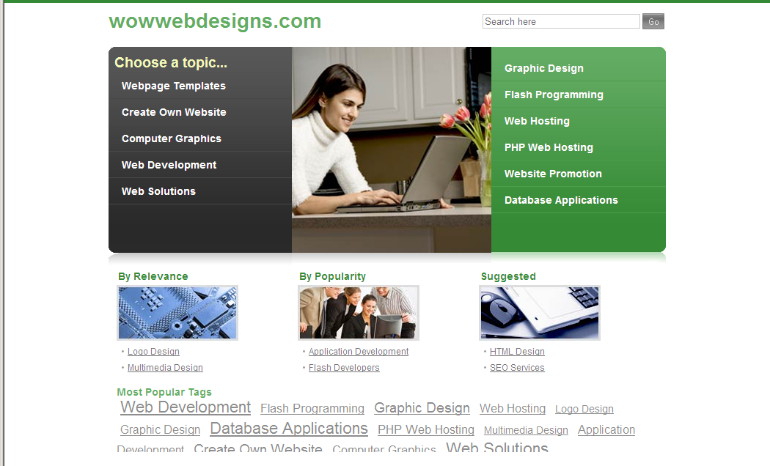
Good Use of Contrasting Colors

Slide 8
Eye Straining Color Combinations
Black text on a red background
Black text on a blue background
Yellow text on a green background

Slide 9
Better Combinations
Black text on a grey background
Black text on a light blue
Black text on antique white

Slide 10
Mind Your Letter Spacing
Text with close letter spacing is difficult to read.
Text with extra letter spacing is easy to read.
Text with reduced letter spacing is difficult to read.

Slide 11
Mind Your Line Spacing
Text with good line spacing is easy to read
Text with reduced line spacing
is difficult to read

Slide 12
Avoid the Fancy Fonts
This font is easy to read....
While Serif fonts are best for the printed page, San Serif fonts are best for viewing on the computer.
This font is difficult to read....
Cursive and fancy writing should only be used for the title or emphasis.

Slide 13
Italics and Boldfacing
Normal fonts are easy to read.
Italic fonts are not so easy to read.
Boldface and Italics font script should only be for emphasis. If all is italic and bold there is no difference and no extra emphasis

Slide 14
Avoid Sleazy Elements
Don't distract with:
blinking or scrolling text
Animated GIFs
Auto-loading sound
Slow Connections may create resentment by wasting time forcing them to load animations and sound files
Readers who are assaulted by blinking ads are more likely to leave the site immediately without clicking on anything, and are far less likely to bookmark the site, return to it, link to it, and recommend it.

Slide 15
Scrolling Text
Reader can't read it at own pace
Forced to read it at designed speed
Might have preferred to read those two sentences quickly and then move on
But because it's scrolling they're forced to sit there and wait for the text to slowly appear.

Slide 16
Always Keep Visitors' Interests In Mind
Scrolling text does nothing to serve the visitor.
If it's on a site it's because the site owner thought, "Let me show how cool I am."
Don't design the site for yourself, design it for the people who will actually use it.

Slide 17
No Text Over Image Backgrounds
Harder to Read
Load Time for Page Longer

Slide 18
DO Make it Easy to Find Stuff
Put some thought into organization
As important as what your pages look like, so actually spend some time on it.
If reader can’t easily find, they will leave

Slide 19
Navigation Should Be Easy to Find (Very Easy)
Web users are impatient, and they're not going to hang around a site very long if they can't find their way around.
Navigation should be a prominent element of your design.
Since it will often take up much less space than other elements, it should stand out enough so it doesn’t get lost amongst a sea of content.

Slide 20
Minimize Clicking!
More Clicking = More likely will leave
Home page simply "welcomes" visitors to site? = Delete Page
Give Visitors Information immediately
Group meaningful amounts of information on each page.
If a page doesn't have at least 400 words combine with another short page

Slide 21
Limit Size of Page
No more than two screenfuls of information
Articles are exceptions
Articles are longer by nature.
Very long articles (more than about 6-7 screenfuls) should usually be chunked into separate pages.

Slide 22
Home Button
Include a way to get back to the home page, on every page.
Lost users like to start over from square one.
Make sure to also include text "Home“
Users might not be able to hit the "Back" button to go back to your home page
Might have entered the middle of your site after clicking a link to it from a search engine or from some other site.

Slide 23
Menu
Include a menu on every page.
On left or the top of each page.
Don't put navigation links only at the bottom of pages
Users will have to scroll down to the bottom to get to them

Slide 24
Capitalization
Don't type more than a few words in ALL CAPS
Used to draw attention to themselves
If everything is in all caps
Everything looks the same, so none of it looks important.
Try making headline stand out
bold, bright color, maybe a little larger
Keep the text that follows it normal

Slide 25
Spelling Checker
Why should I trust your information when you aren’t educated enough or are not careful to spell right.

Slide 26
Links
Make links blue or underlined, or both
Don't underline words if they're not links
Don't open internal links in a new window
Test your links
Remove broken or incomplete links

