Slide 1
Web Page Design
ICT
Ms. McGrew

Slide 2
www.weebly.com
Although there are many free web design programs on the Internet, we will be using Weebly for this class.

Slide 3
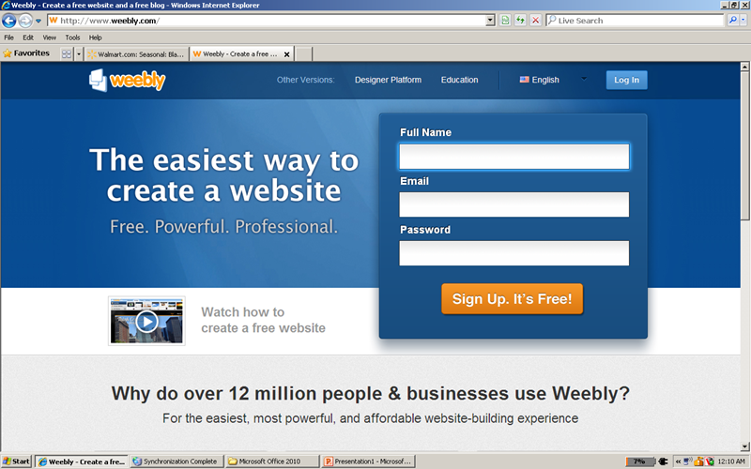
Create your account

Slide 4
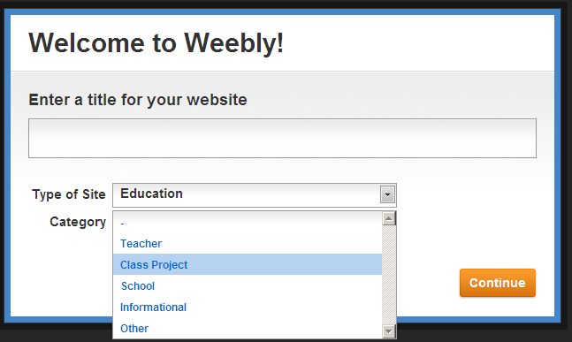
Create a Name for Your Website
Choose
Website Name
Education
Class Project

Slide 5
Webpage Design Elements
Placement of
Text
Links
Pictures
Page divisions will be done further later as the page is designed.

Slide 6
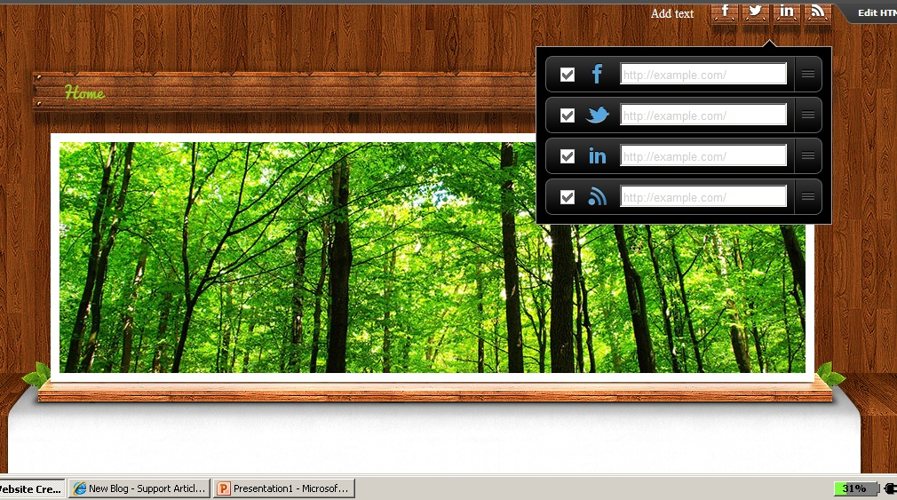
Create Links to Social Networks

Slide 7
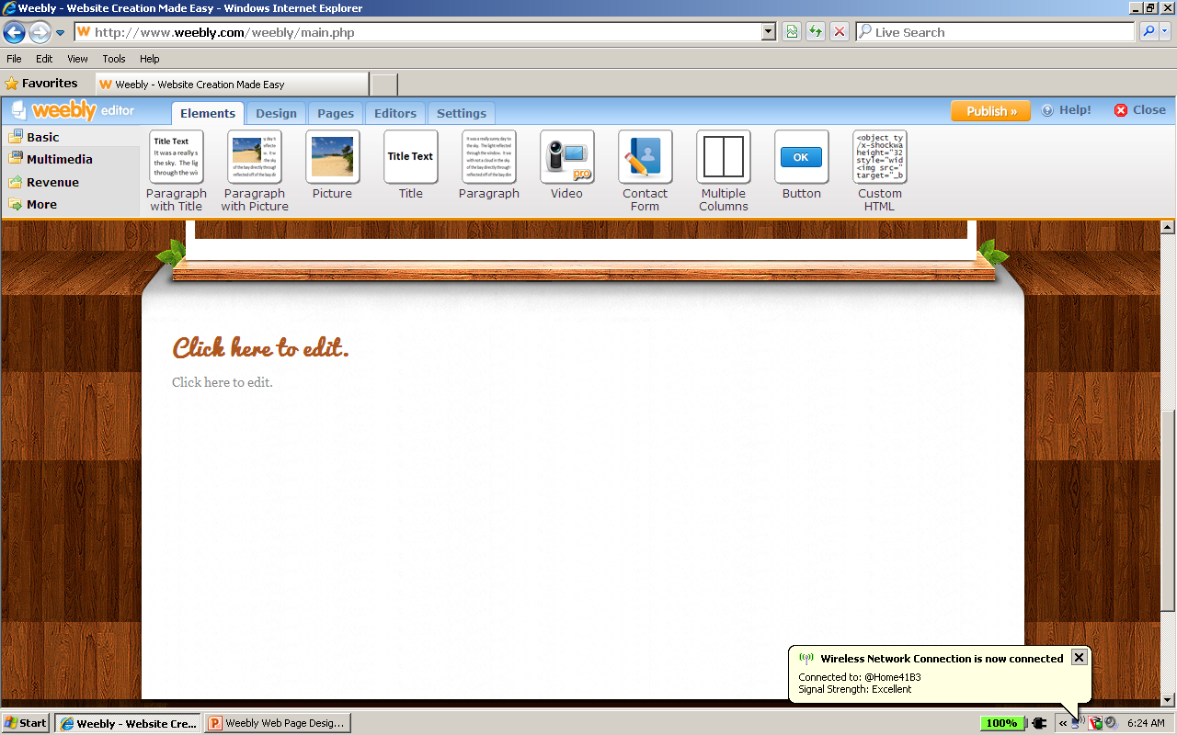
Multiple Columns

Slide 8
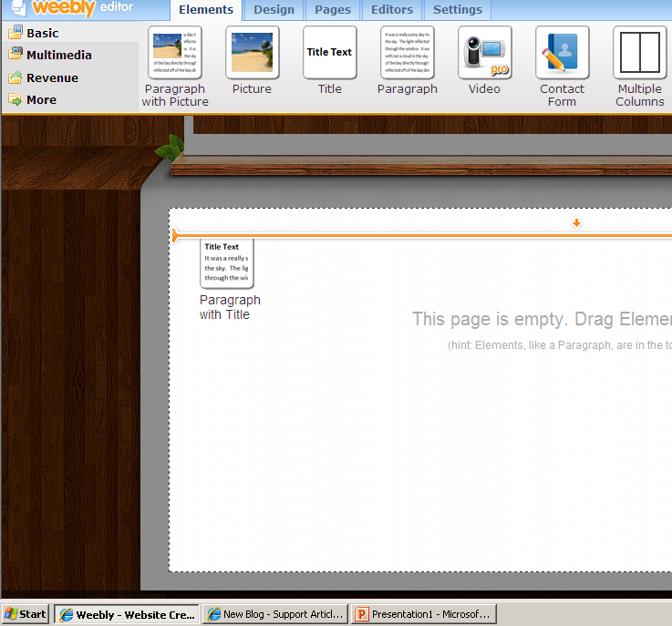
Adding Elements
Dividing elements can be dragged on to the page

Slide 9
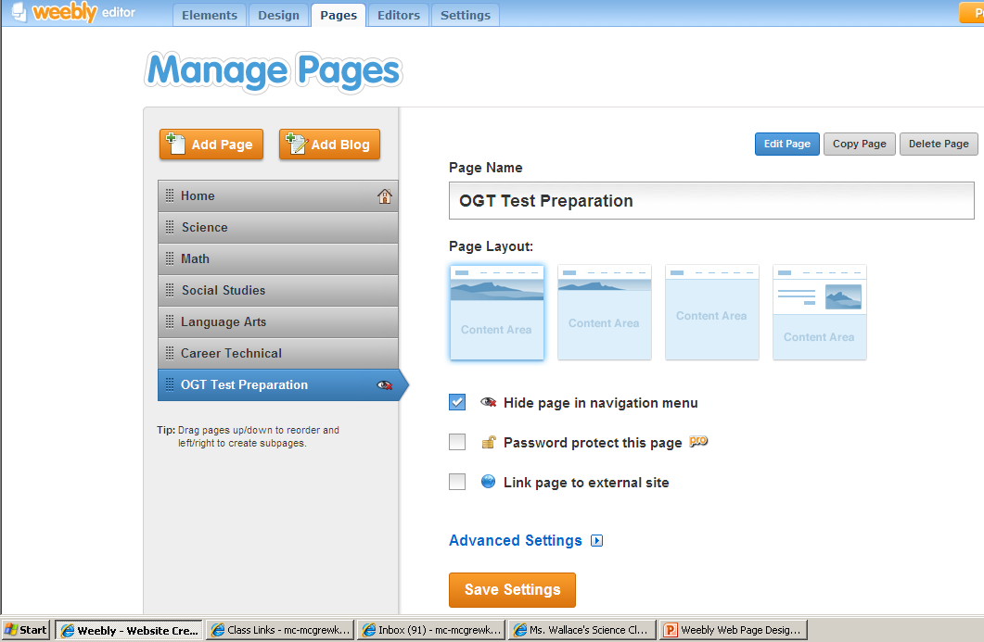
New Pages
Click on Pages Tab
Can copy design of already created
Can create new
Name the Page

Slide 10
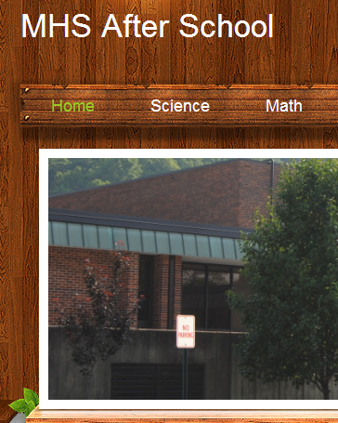
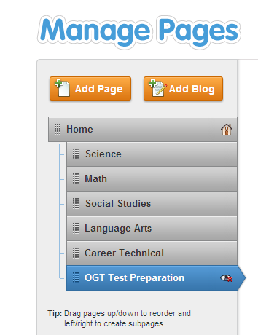
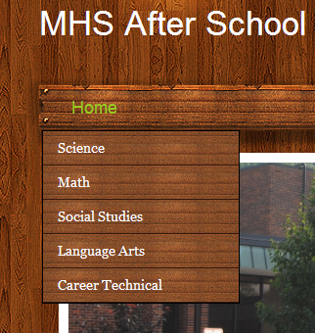
Creating Menus
At this Level the pages will be tabs at top of Page
Pushed in they will become links from the Home Page

Slide 11
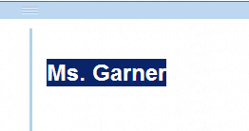
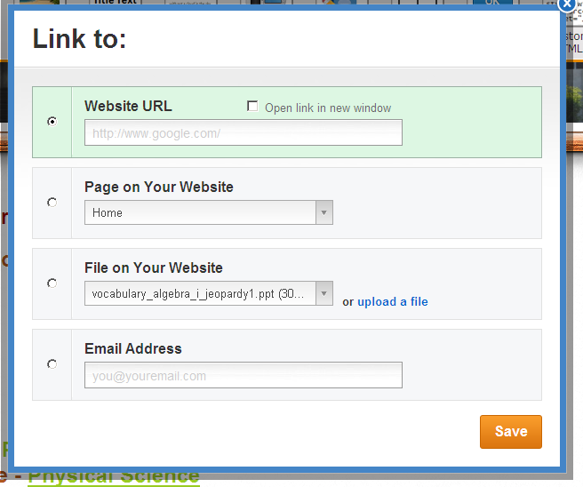
Creating Hyperlinks
Highlight or click on what you want to hyperlink
Click on the Create Link button
Choose the option
To existing page
To page on your web page
Upload a file to be linked
To an email address

Slide 12
Changing Text
Bold Face
Italics
Underline
Color
Size
Remove Formatting
Alignment
Undo - Redo

Slide 13
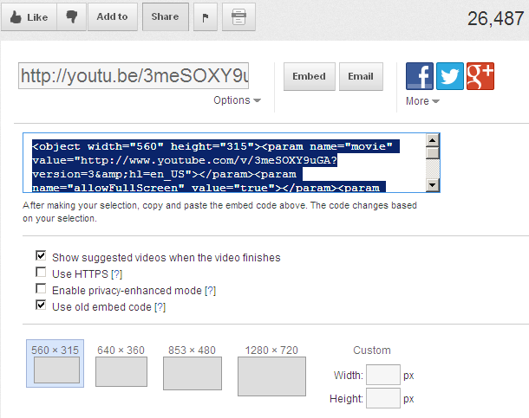
Insert Video from YouTube
Drag to Page
Go to Desired Video on YouTube
Click on the “Share” option
Click on “Embed”
Make sure to check “Use Old Embed Code”
Paste the code into the Custom HTML box previously inserted in webpage.

Slide 14
Change or Edit Pictures
Click on “Edit Image”
Select “Add Image”
Upload to webpage
Can also
Add Text
Rotate
Change Opacity
Fade
Change the Effects of the Picture

Slide 15
Add Contact Form
Reputable websites
allow for a way to contact the web designer
Give comments for webpage
Ask for further information

